Slide 1



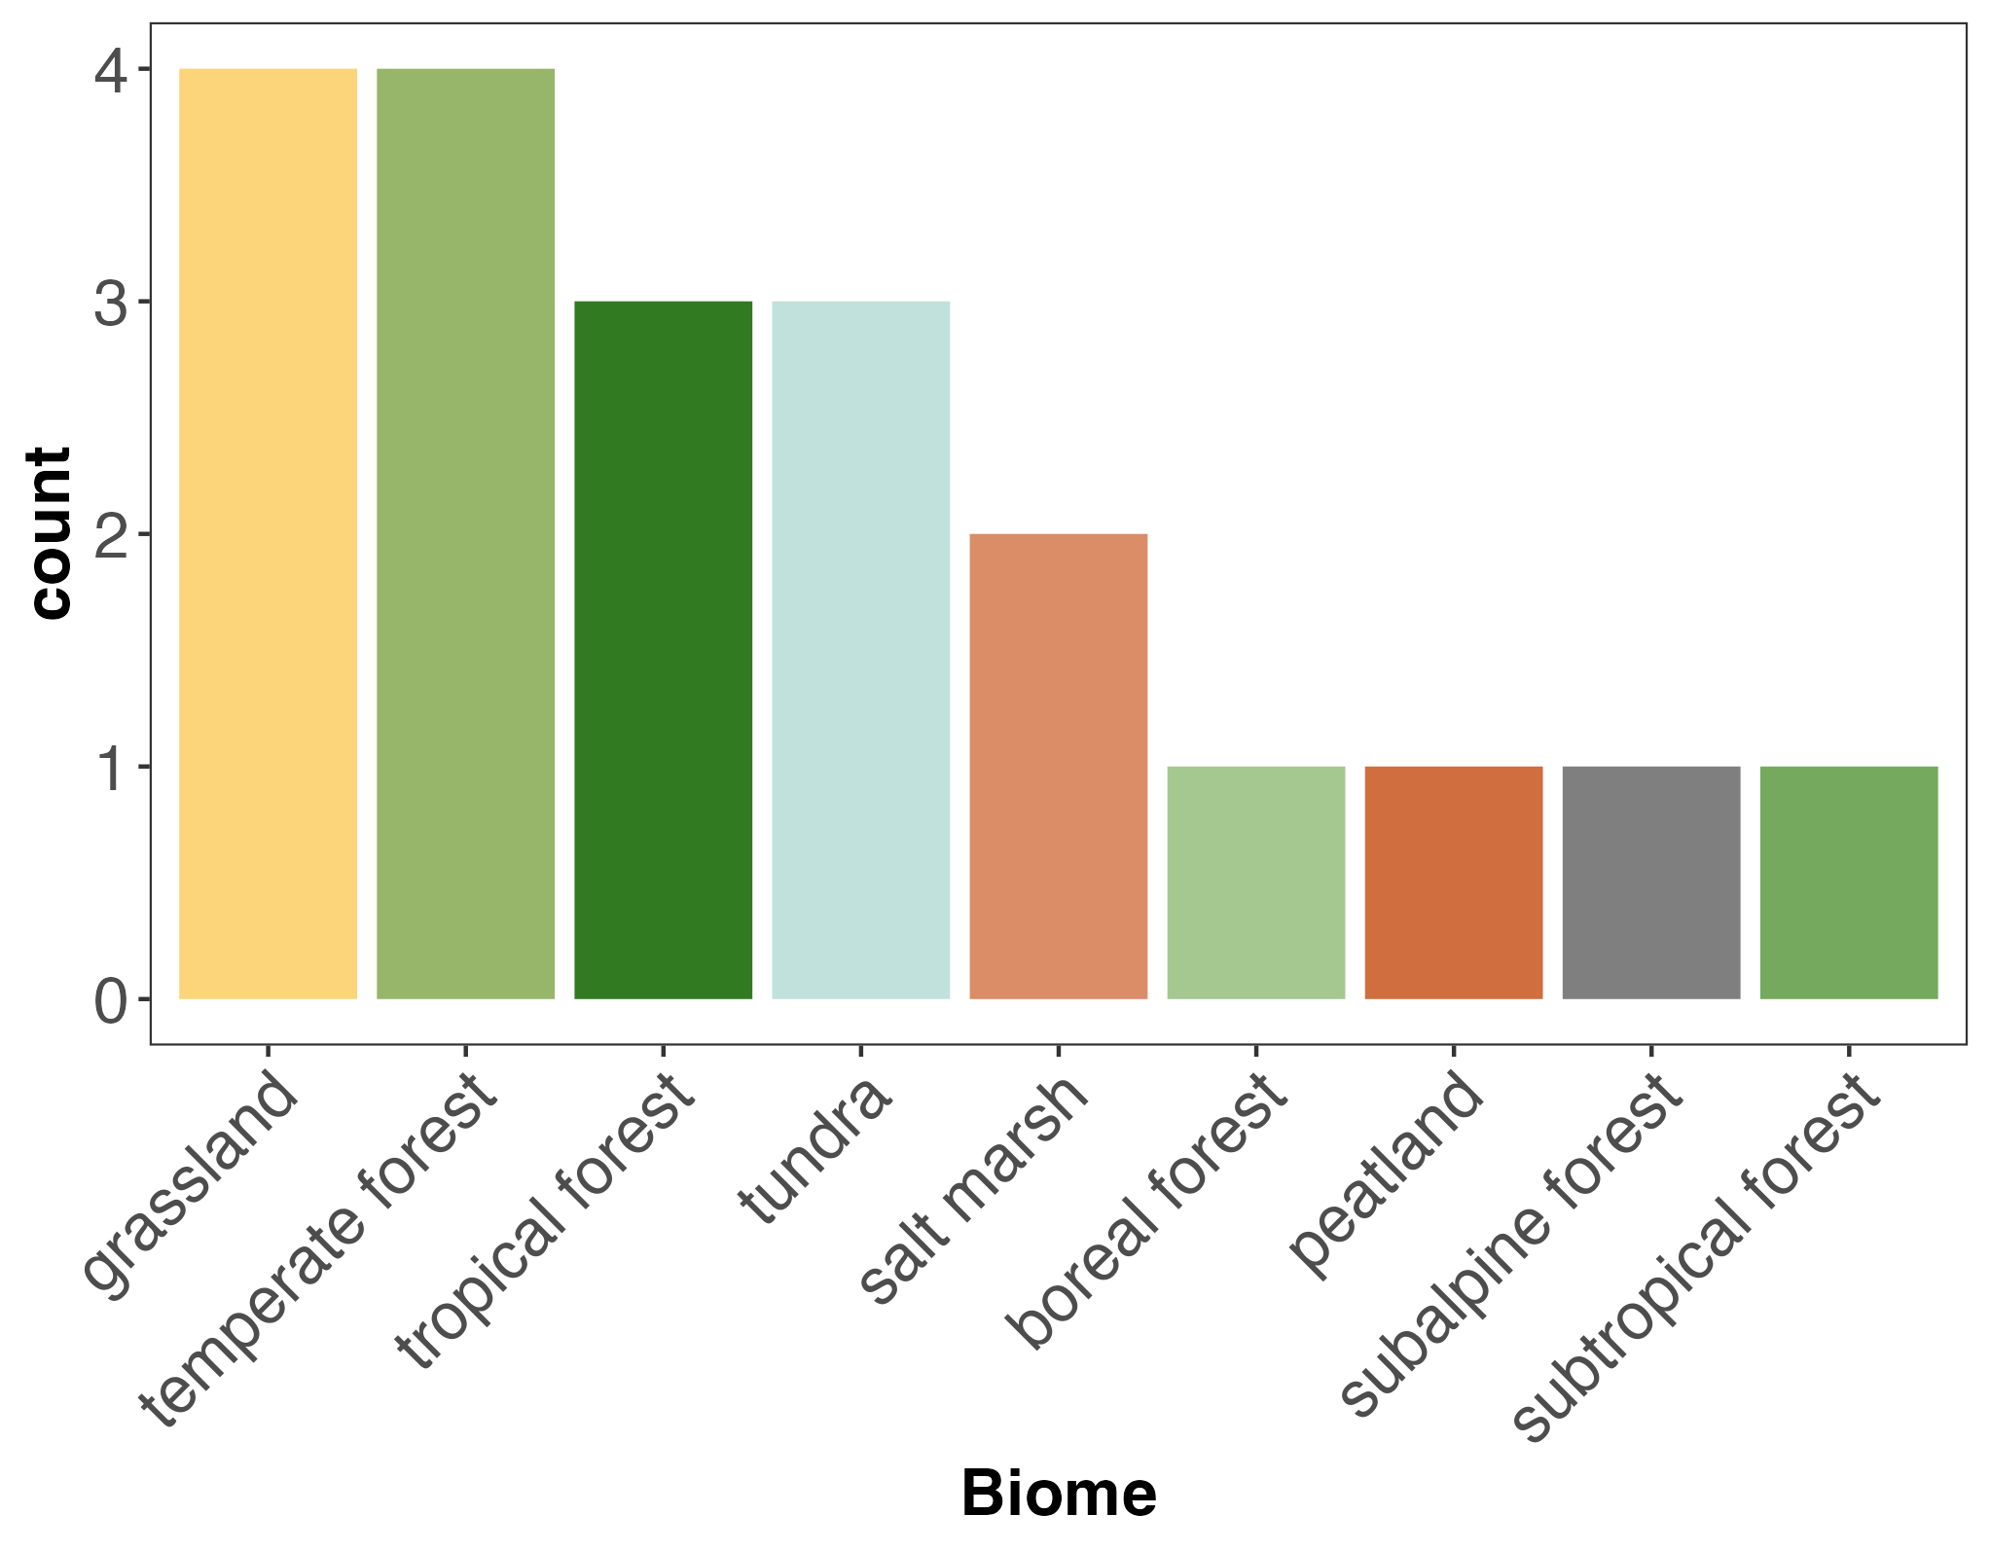
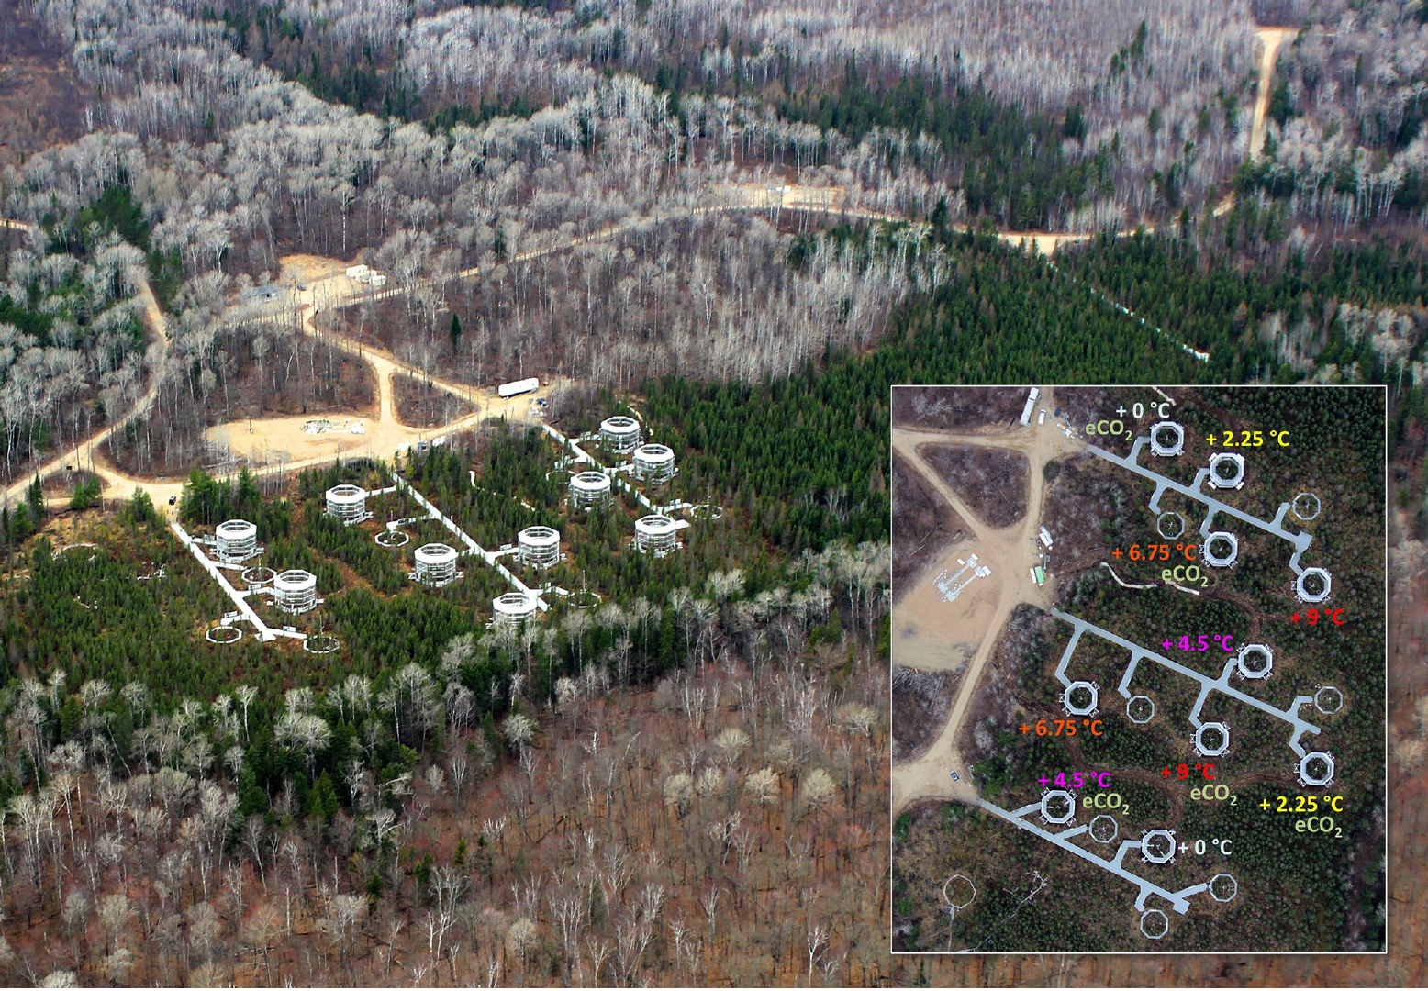
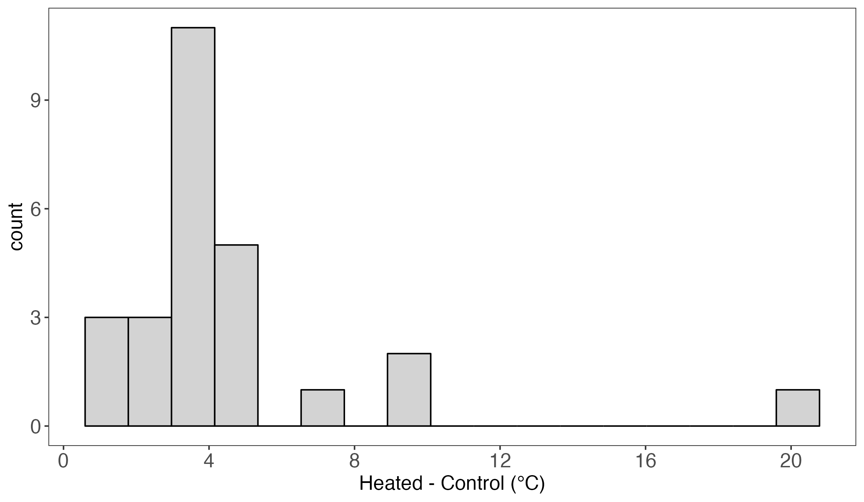
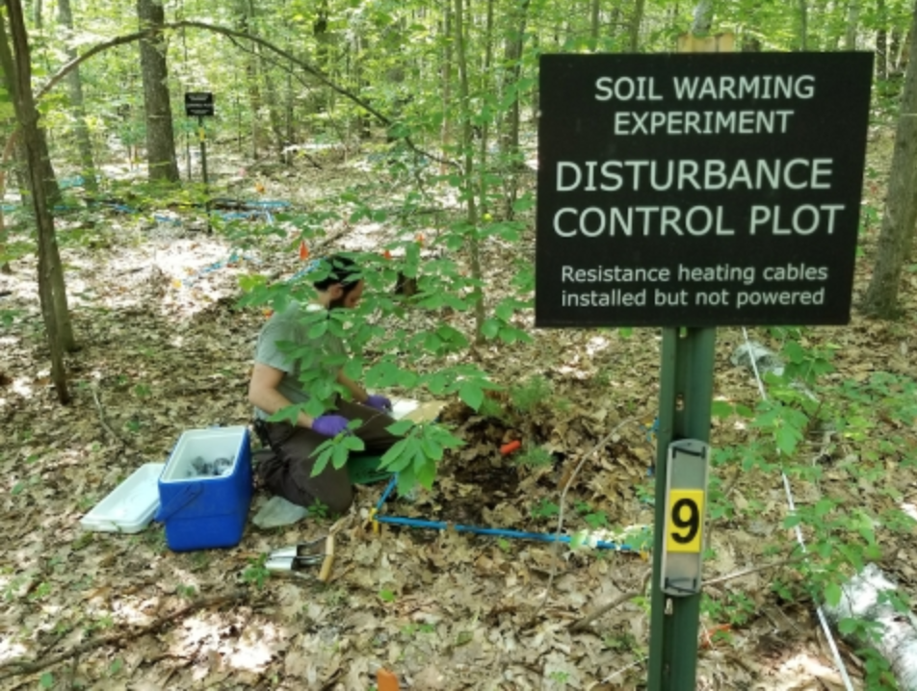
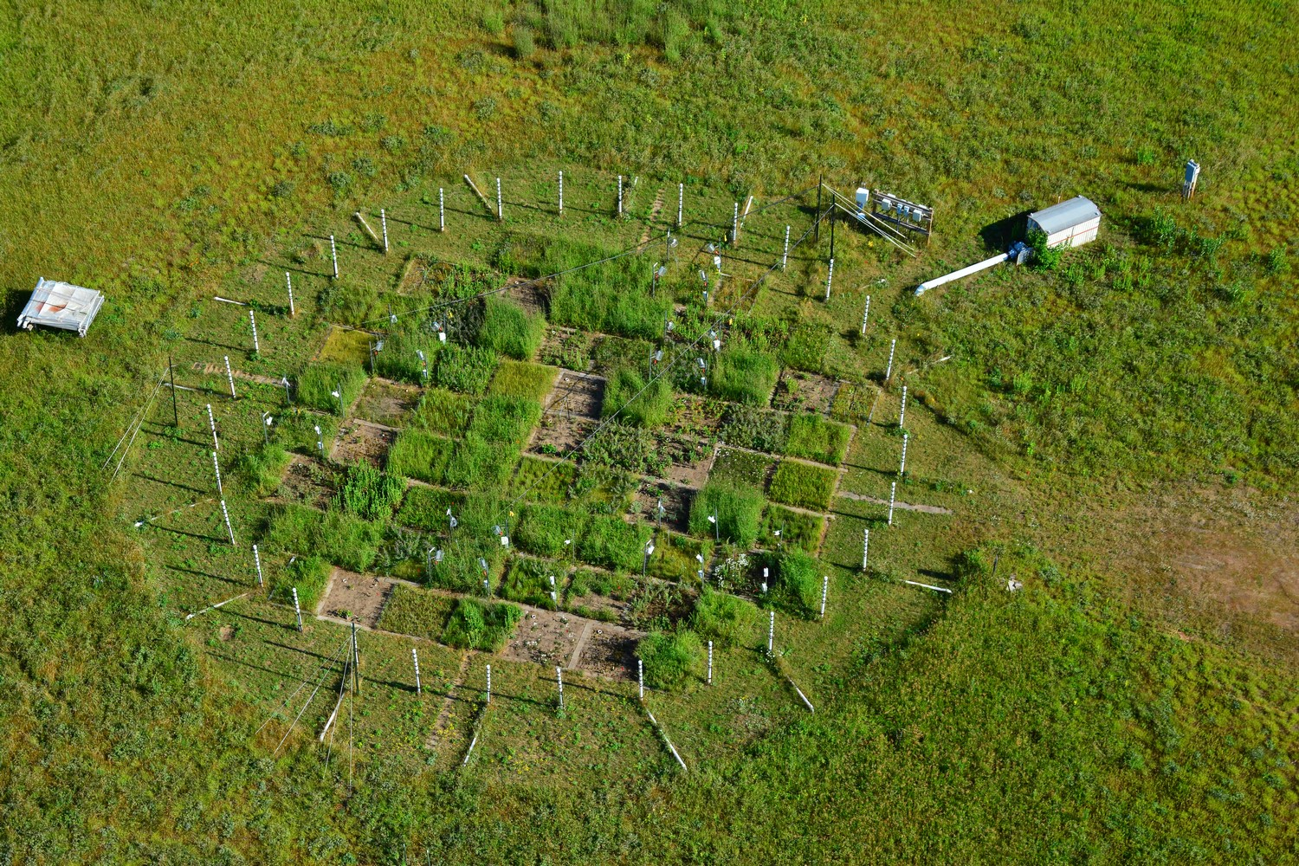
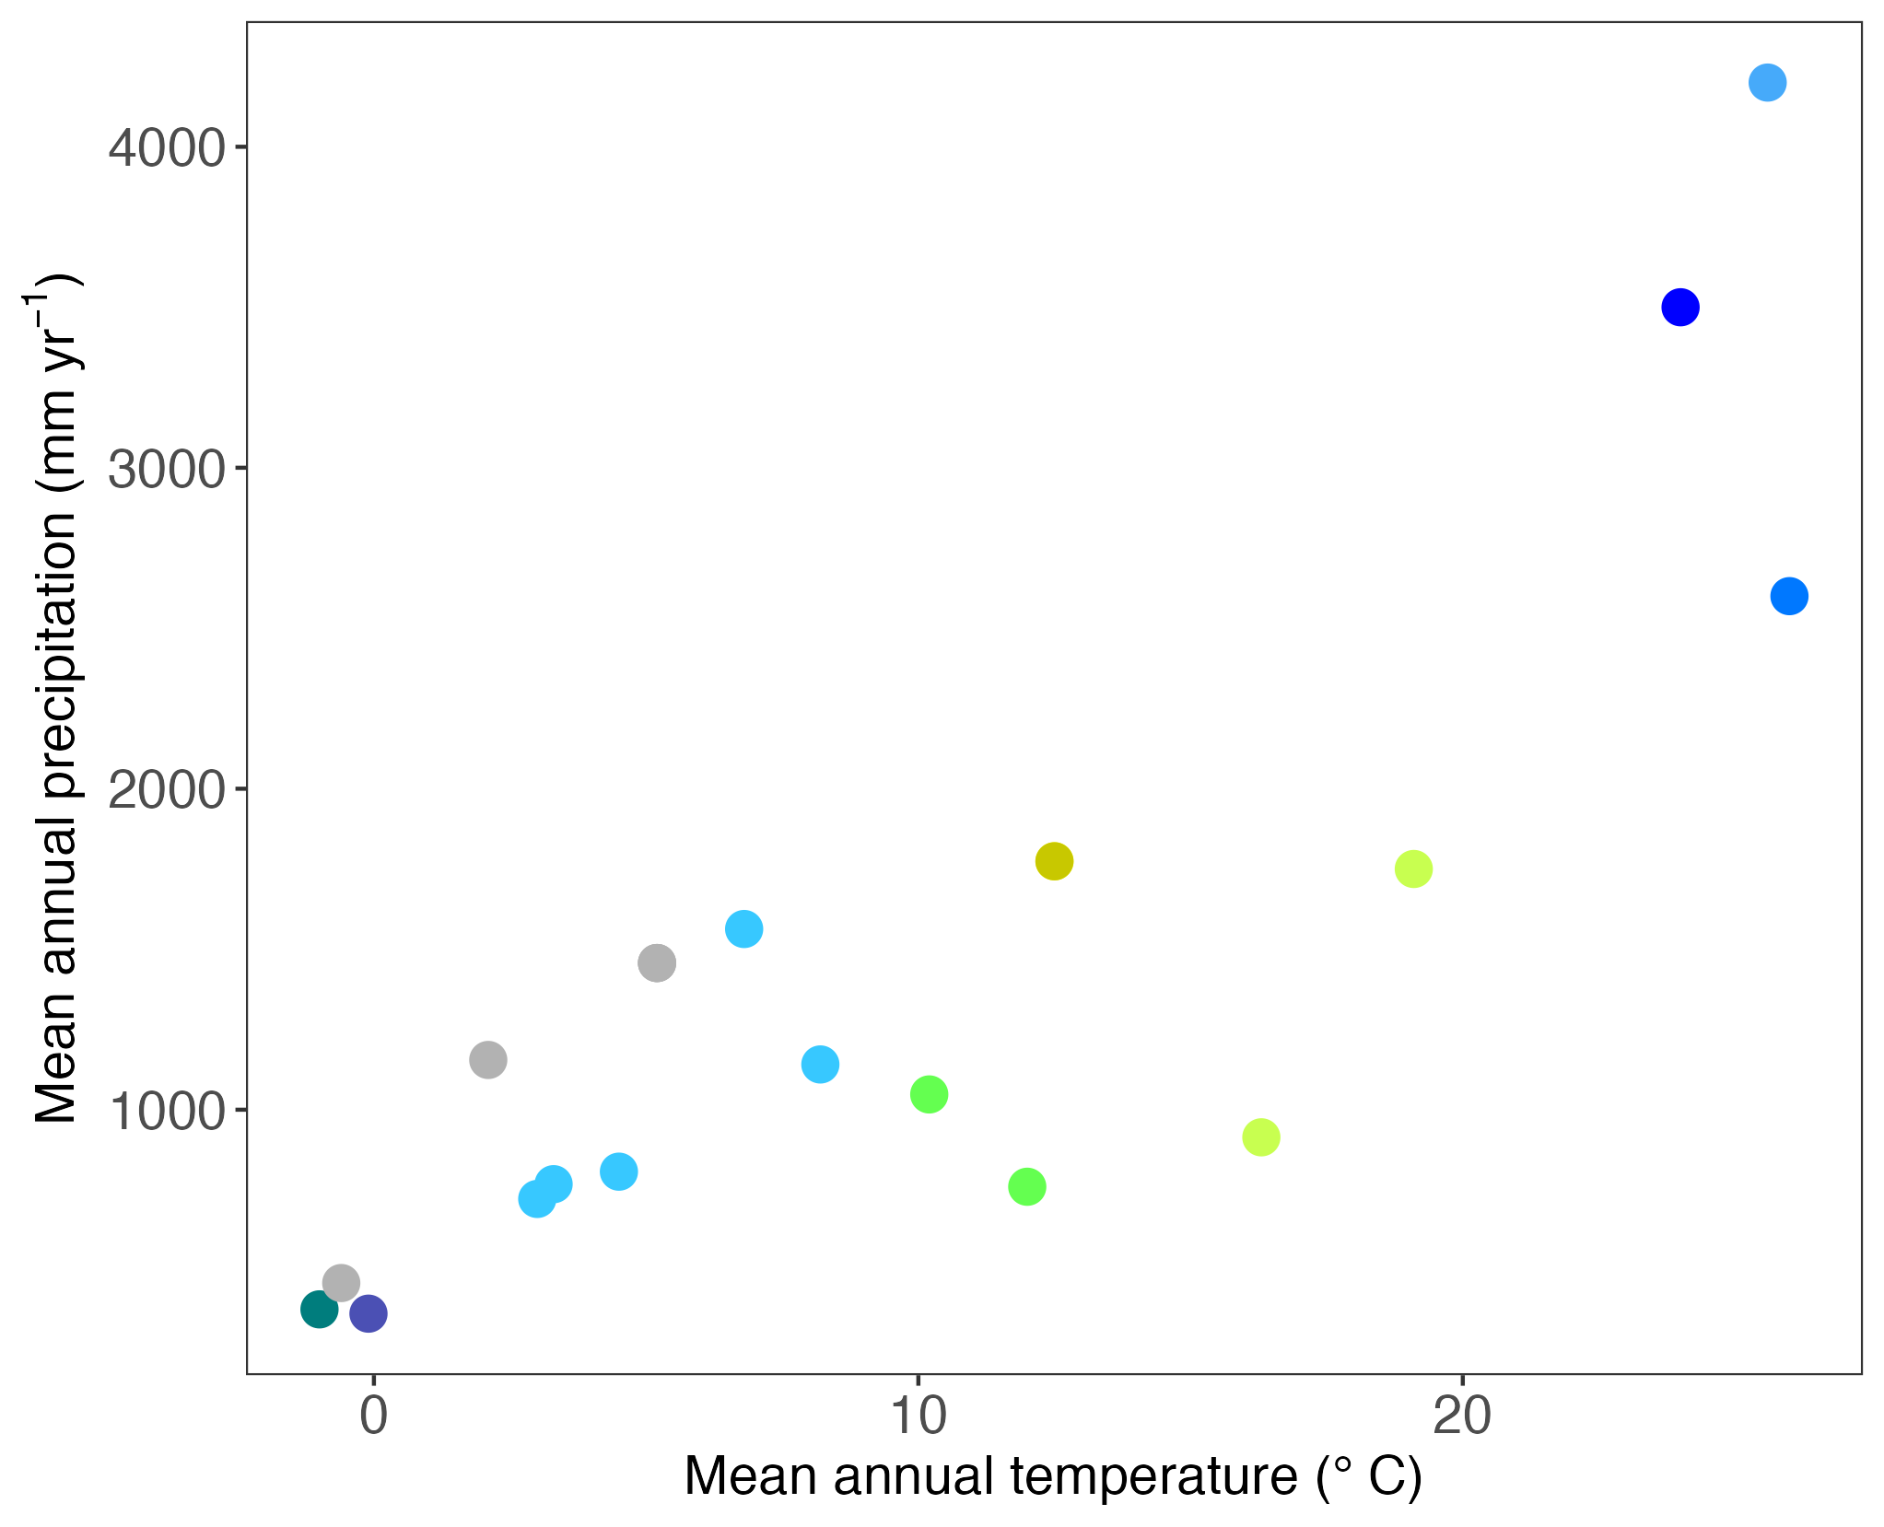
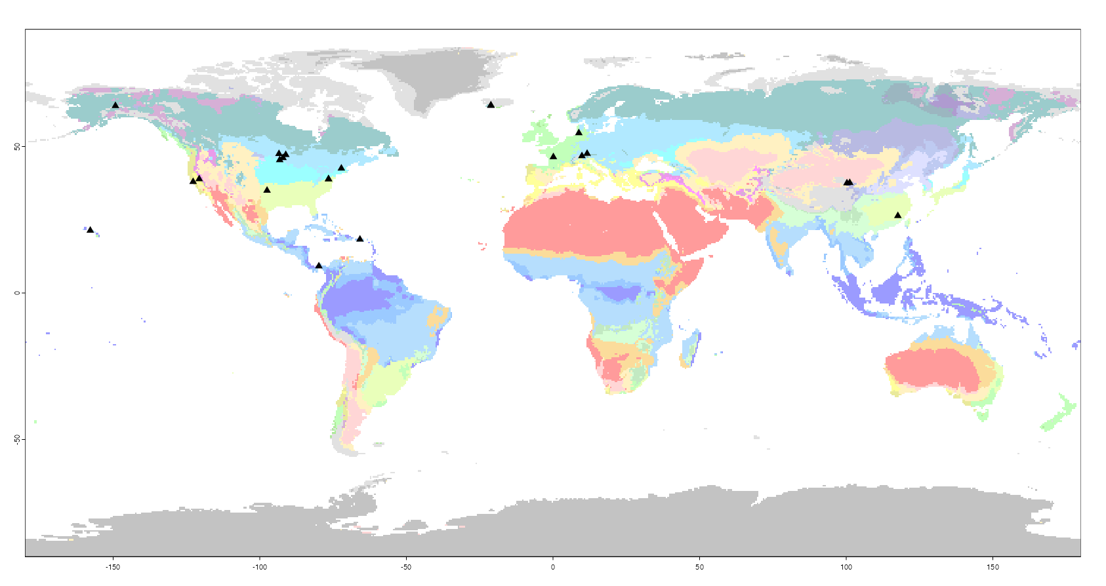
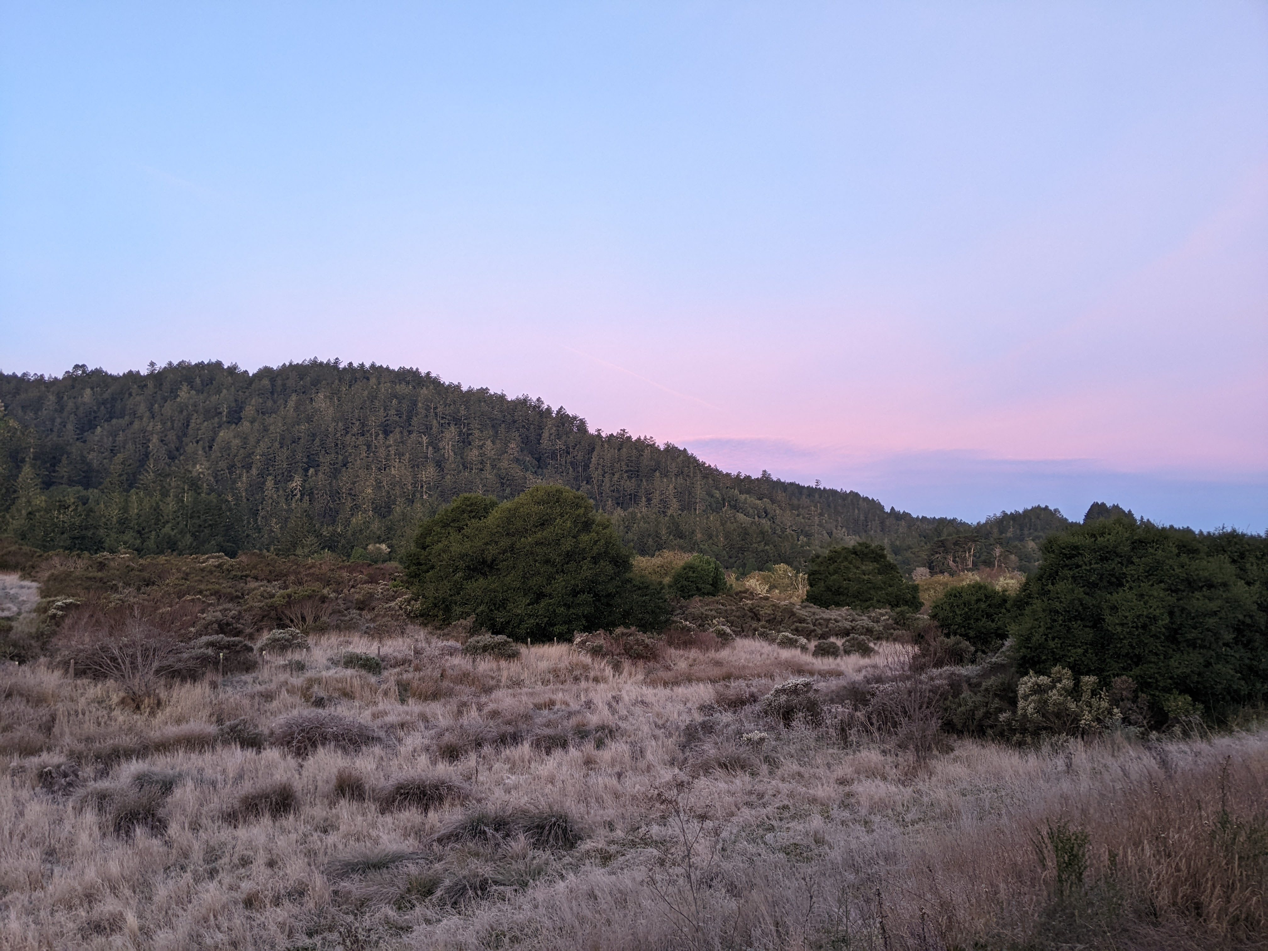
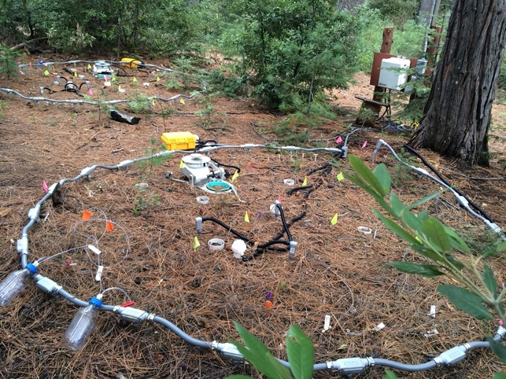
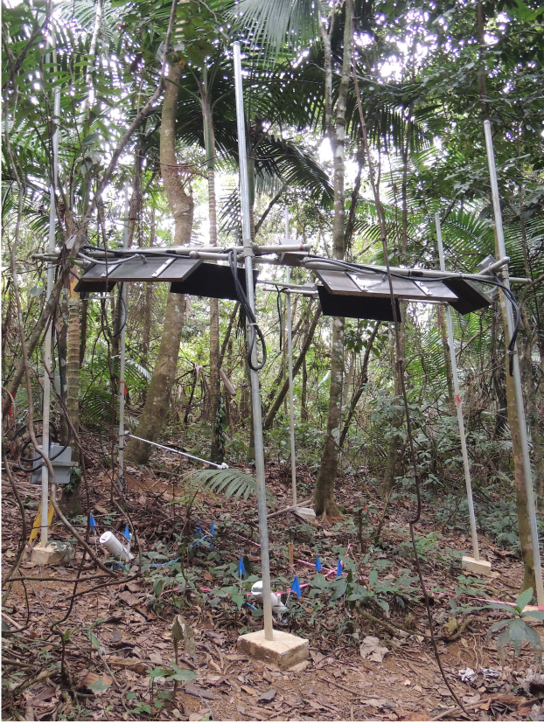
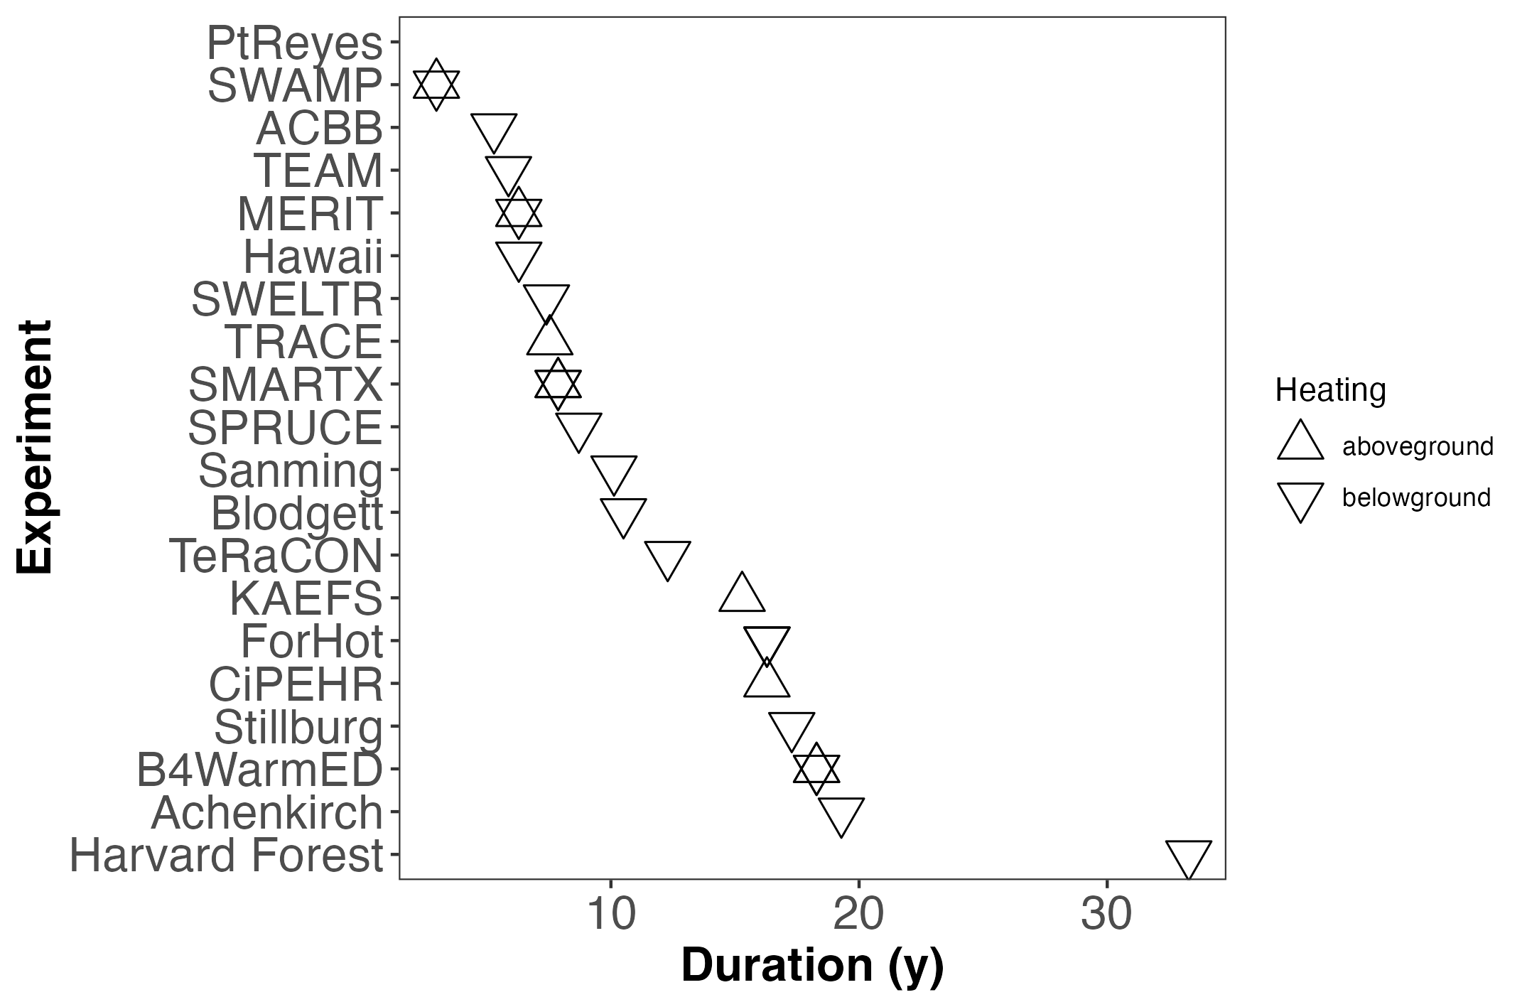
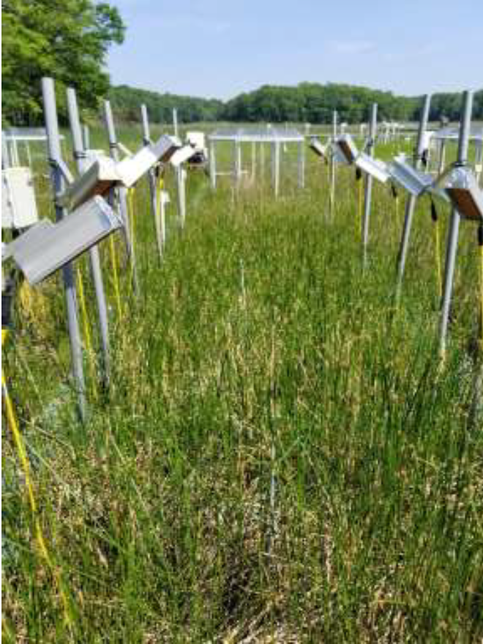
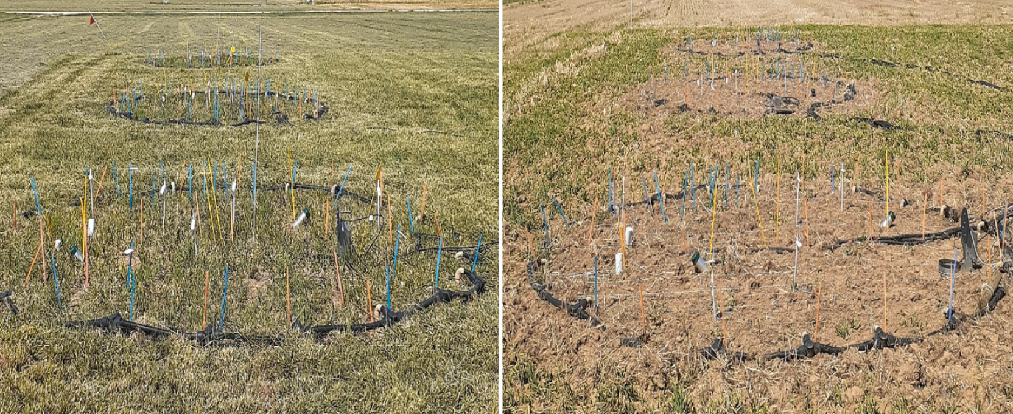
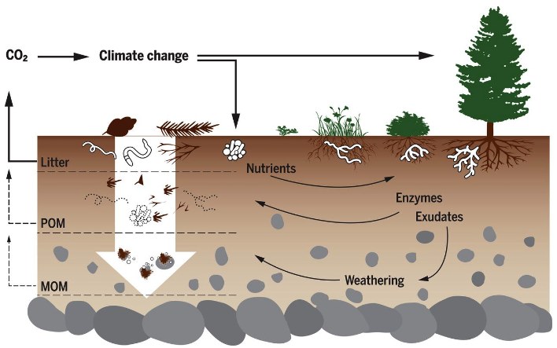
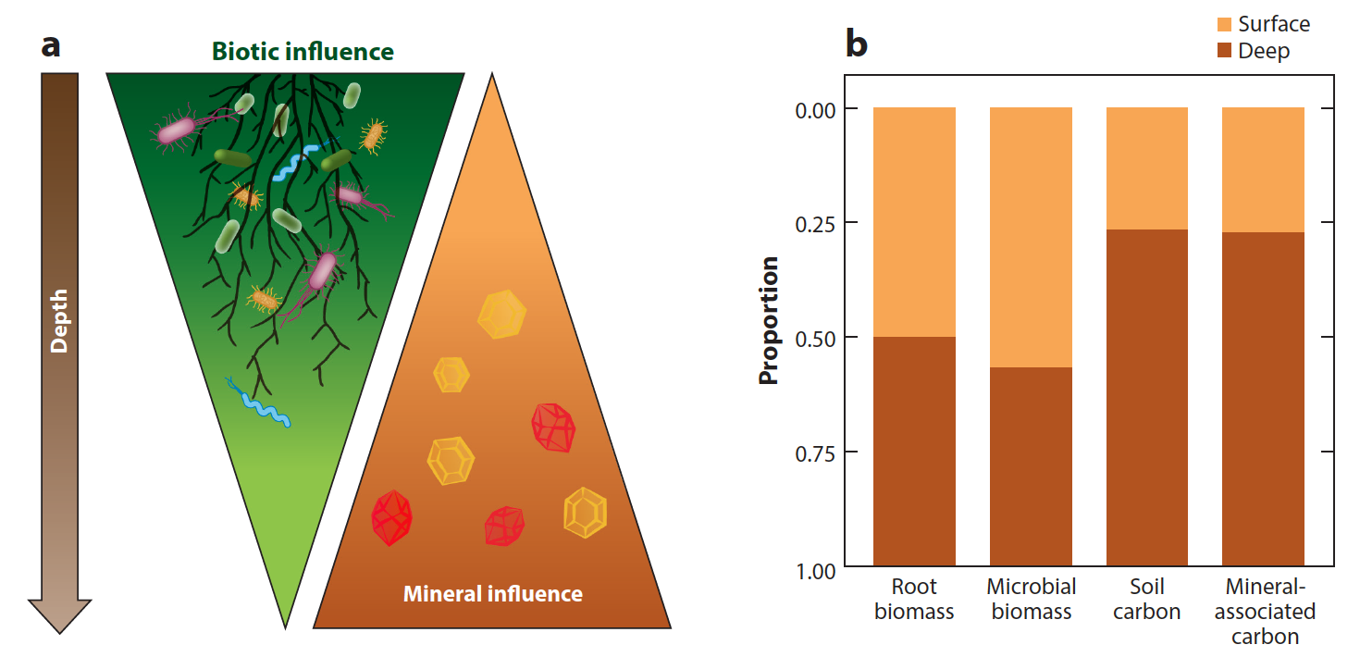
DeepSoil2100 and SWEDDIE:
Synthesizing Warming Experiments to Depth—Data Integration Effort
`
`
`
`
`
`
Jeffrey Beem-Miller^{1,2}, Margaret Torn², Peter Reich¹, William Riley², and Michael Schmidt³
Database Pipeline:
¹ University of Michigan, Institute for Global Change Biology, Ann Arbor, MI, USA, ² Lawrence Berkeley National Lab, Climate and Ecosystem Sciences Division, Berkeley, CA, USA, ³ University of Zurich, Zurich, Switzerland
1. Enter core data
Hybrid Data Ingestion
2. Annotate raw measurement data
Colored boxes represent core data—template-based
Black boxes represent measurement data–keyed translation
‘dat’ files can be any kind of data, e.g., sensor based time series, soil core measurements, flux chamber measurements, microbial community characterizations, etc.
3. QA/QC
4. Query database and compile custom report
Data Model
experiment
site
plot
meta
meta
meta
datXXX
datSMStk
datSMTDR
datTemp
datSoilC
meta
meta
meta
meta
meta
Next Steps
Key Synthesis Questions
annotating temperature and moisture data
database launch manuscript and site/infrastructure comparison
coordinated sampling campaign
How will soil C stocks respond to warming?
Q10s derived from soil warming experiments indicate potential losses by 2100¹
500
inputs
+
Change in soil C stocks by 2100
(Pg C)
250
3) How does warming affect coupling of above and belowground processes?
0
-250
+ decomp
-500
Ensemble of global soil C models
Model mean
Vegetation response rate v. soil
Microbial community shifts due to nutr. & veg. changes
(Fig. adapted from ¹Todd-Brown et al., 2018, DOI:10.5194/bg-15-3659-2018)
Multi-model mean
What and why
± sd
DeepSoil2100
What? Network of whole-ecosystem warming experiments with documented warming extending below topsoil (> 30 cm)
Why? Leverage experimentalist & modeler knowledge across sites; deploy coordinated sampling campaigns
SWEDDIE
What? Harmonized database built with FAIR principles and a flexible architecture to encompass a dynamic and broad range of data
Why? Synthesize current empirical knowledge of ecosystem warming responses for comparison across site gradients and improved model benchmarking
2) How do soil C warming responses change with depth?
~75% of soil C < 20 cm
mechanisms of soil C persistence and abundance diverge with depth²
(Fig. from Hagedorn et al., 2019, DOI:10.1126/science.aax4737)
Acknowledgments
This material is based upon work supported by the U.S. Department of Energy, Office of Science, Office of Biological and Environmental Research under contract number DE-AC02-05CH11231
(Fig. from ² Hicks Pries et al., 2023, DOI:10.1146/annurev-ecolsys-102320-085332)
Notes:
140x86.53 cm (1.618 ratio)
max size: 1978 mm width × 1183 mm height
- add HI, Stillberg, & MERIT sites
- parent material?
1686x894 = map in px

